Slide 1
Theory of change and
mid-level theory
Howard White
CEO, Campbell Collaboration
Uganda Evaluation Week, 11-15 February 2019
@campbellreviews @HowardNWhite

Slide 2
Sit in a group the number corresponding to the case you want to discuss
Teacher absenteeism
Teenage pregnancy
Reducing drug use
Adoption of improved seed varieties
Traffic congestion
Employment for people with disabilities
Open space sexual violence
Solar home systems
No more then 5 per group

Slide 3
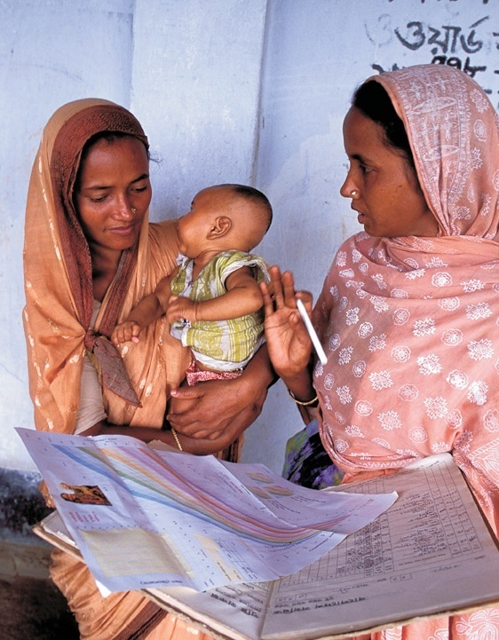
Impact evaluation: an example
Why did the Bangladesh Integrated Nutrition Program (BINP) fail?
The case of the Bangladesh Integrated Nutrition Project (BINP)

Slide 4
Comparison of impact estimates

Slide 5
Summary of theory

Slide 6
The theory of change
Right target group for nutritional counselling
PARTICIPATION RATES WERE UP TO 30% LOWER FOR WOMEN LIVING WITH THEIR MOTHER-IN-LAW

Slide 7
The theory of change
Knowledge acquired and used

Slide 8
The theory of change
The right children are enrolled in the programme

Slide 9
The theory of change
Supplementary feeding is supplementary

Slide 10
Lessons from BINP
Apparent successes can turn out to be failures
Outcome monitoring does not tell us impact and can be misleading: only rigorous impact evaluation does this
A theory based impact evaluation shows if something is working and why,and so has more lessons for policy
But the attribution analysis matters
And independence can matter
Outcome monitoring cannot tell us about results – what difference we made…
Only impact evaluation can do that

Slide 11
What is a theory of change?
A theory of change documents the causal links between inputs, processes, outputs and intermediate and final outcomes, and identifies the underlying assumptions.
Assumptions are what needs to be true for this causal chain to operate.

Slide 12
Exercise one
Pick the main outcomes of interest for your topic area
Select a specific intervention to achieve those outcomes

Slide 13
Overview ToC for school feeding
Nutritious meals
prepared and
served in correct
portions
Children eat the meals
Children
more
attentive
Better
learning
outcomes
Higher
attendance
Assumptions
Food available in sufficient quantity and quality at right time
Other inputs (e.g. teachers) are present

Slide 14
Steps in building theory of change
Define intervention, objectives and outcomes
Lay out main steps in causal chain
Identify underlying assumptions
Add a temporal dimension
Identify key evaluation questions
Validate and revise

Slide 15
Step One
Clearly define the intervention, its objectives and outcomes of interest
Be precise in terms of outcome definition and proposed measurement
And unanticipated outcomes may be uncovered

Slide 16
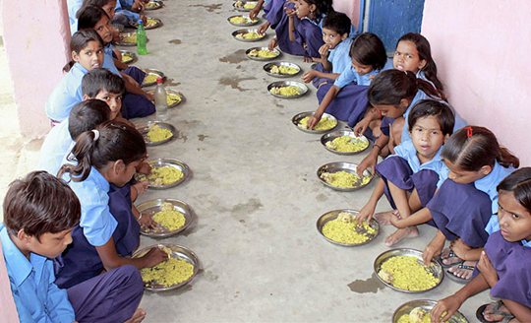
Define the intervention: school feeding
Which meal?
Do guidelines exist?
How is food to be procured?
What is planned to ensure parents know about it?
What training will be provided to those preparing food?
Photo@Indian Express

Slide 17
Be precise in variable definition and data sources
Attendance
Child present in school for whole school day
Who will you ask this to: teacher, child, parent?
Learning outcomes
Use national exams or own learning outcome tests
Photo@Dominic Chavez/World Bank
Phpto@AIPVT.com

Slide 18
Unanticipated outcomes
Less time spent in classroom
Lower learning outcomes
Nutritious meals
prepared and
served in correct
portions
Children eat the meals
Children
more
attentive
Better
learning
outcomes
Higher
attendance

Slide 19
Steps Two and Three
Map out the main steps in the causal chain (input, process, activities, outputs, intermediate and final outcomes)
And then identify the assumptions which underpin these steps
Specific and detailed, don’t use silos
Empathy

Slide 20
A ‘silo’ theory of change for school meals
Inputs
Money
Activities
Identify schools
Outputs
Staff equipped to prepare meals
Staff
Provide guidance and training
Set up procurement and distribution
Distribute food stuffs
Distribute cooking equipment
School-based facilities for meal preparation
Nutritious meals prepared with correct portions
Outcomes
Impact
Higher attendance
Children more attentive in class
Better learning outcomes
Better labour market outcomes
Higher productivity
Better life
Children eat the meals

Slide 21
The ‘un-siloed’ ToC
Staff
Identify project school
Kitchens
equipped
Nutritious meals
prepared and
served in correct
portions
Children eat the meals
Children
more
attentive
Better
learning
outcomes
Set up procurement,
Production and
distribution systems
Foodstuffs
produced,
procured or
received
Higher
attendance
Develop training
and guidance
materials
Trained school-
level staff in
place
Money
Identify and train
trainers
Assumptions
Funds
available on
time
Data available for
school selection
Equipment is
distributed and
usable
Food used for
school meals and
properly
prepared
Parents are
aware of
school
feeding and
value it
Other inputs
(e.g.
teachers)
are present
Appropriately
Qualified and
Motivated
Project staff
Those trained
understand tasks
Food available in
sufficient
quantity and
quality at right time
Meals are palatable

Slide 22
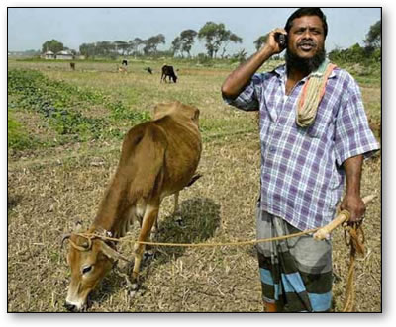
Empathy
Who are these people?
What do they really want?
And what’s it going to cost me?
How would that benefit me?

Slide 23
Step Four
Add a temporal dimension
Define project time line accurately and realistically
Think through time required to observe sufficient change in outcome in a sufficiently large group to measure impact

Slide 24
School feeding: timeline
6-12 months
13-36 months
37-42 months
15-20 years
later
Project set up and start up
Project implementation
End of Phase I
Endline data collection and analysis.
Impact analysis on attendance, attentiveness and learning outcomes
Post endline survey for
analysis of
labour market outcomes
Baseline survey toward end of this period
Mid-term process evaluation.
Impact analysis on attendance and attentiveness

Slide 25
Step Five
Identify the Evaluation Questions
Interrogate the causal chain, and ask ‘what needs to be in place for this to work’?
Different types of evidence (factual and counterfactual)
Probe potential weak links
What questions most need answering (and how)?
Look for second generation questions which tackle design issues

Slide 26
Exercise
Sketch a time line for the design, implementation and evaluation of your intervention

Slide 27
What needs to be in place?
Staff
Identify projects
school
Kitchens
equipped
Nutritious meals
prepared and
served in correct
portions
Higher
attendance
Better
learning
outcomes
Set up
procurement,
production and
distribution systems
Foodstuffs
produced,
procured or
received
Children
more
attentive
Develop training
and guidance
materials
Trained school-
level staff in
place
Money
Identify and train
trainers
Assumptions
Funds
available on
time
Data available for
school selection
Equipment is
distributed and
usable
Food used for
school meals and
properly
prepared
Parents are
aware of
school
feeding and
value it
Other inputs
(e.g.
teachers)
are present
Those trained
understand tasks
Appropriately
qualified and
motivated
project staff
Food available in
sufficient
quantity and
quality at right time

Slide 28
Different types of evidence
Staff
Identify projects
school
Kitchens
equipped
Nutritious meals
prepared and
served in correct
portions
Higher
attendance
Better
learning
outcomes
Set up
procurement,
production and
distribution systems
Foodstuffs
produced,
procured or
received
Children
more
attentive
Develop training
and guidance
materials
Trained school-
level staff in
place
Money
Identify and train
trainers
Counterfactual
Factual
Assumptions
Funds
available on
time
Data available for
school selection
Equipment is
distributed and
usable
Food used for
school meals and
properly
prepared
Parents are
aware of
school
feeding and
value it
Other inputs
(e.g.
teachers)
are present
Those trained
understand tasks
Appropriately
Qualified and
Motivated
Project staff
Food available in
sufficient
quantity and
quality at right time

Slide 29
Different types of evidence
Staff
Identify projects
school
Kitchens
equipped
Nutritious meals
prepared and
served in correct
portions
Higher
attendance
Better
learning
outcomes
Set up
procurement,
production and
distribution systems
Foodstuffs
produced,
procured or
received
Written or verbal test of representative sample of those trained
Children
more
attentive
Develop training
and guidance
materials
Trained school-
level staff in
place
Money
Identify and train
trainers
Counterfactual
Factual
Assumptions
Funds
available on
time
Data available for
school selection
Equipment is
distributed and
usable
Food used for
school meals and
properly
prepared
Parents are
aware of
school
feeding and
value it
Other inputs
(e.g.
teachers)
are present
Those trained understand tasks
Those trained
understand tasks
Appropriately
Qualified and
Motivated
Project staff
Food available in
sufficient
quantity and
quality at right time

Slide 30
Different types of evidence
Staff
Nutritious meals served in correct portions and content
Identify projects
school
Kitchens
equipped
Nutritious meals
prepared and
served in correct
portions
Higher
attendance
Better
learning
outcomes
Set up
procurement,
production and
distribution systems
Foodstuffs
produced,
procured or
received
Children
more
attentive
Develop training
and guidance
materials
Trained school-
level staff in
place
For example, India midday meals programme: “As per a survey conducted from May 13, 2014, to July 22, 2015, 51 meals were tested and 27 of the samples had less than the required 12 gm of protein. As per guidelines set by the Union Government, the midday meal programme for primary students must have 450 Kcal and 12 gm of protein.”
Nutritional analysis of school meals
Money
Identify and train
trainers
Counterfactual
Factual
Assumptions
Funds
available on
time
Data available for
school selection
Equipment is
distributed and
usable
Food used for
school meals and
properly
prepared
Parents are
aware of
school
feeding and
value it
Other inputs
(e.g.
teachers)
are present
Those trained
understand tasks
Appropriately
Qualified and
Motivated
Project staff
Food available in
sufficient
quantity and
quality at right time

Slide 31
Potential weak links
Staff
Identify projects
school
Kitchens
equipped
Nutritious meals
prepared and
served in correct
portions
Higher
attendance
Better
learning
outcomes
Set up
procurement,
production and
distribution systems
Foodstuffs
produced,
procured or
received
Children
more
attentive
Develop training
and guidance
materials
Trained school-
level staff in
place
Money
Identify and train
trainers
Assumptions
Equipment is
distributed and
usable
Funds
available on
time
Data available for
school selection
Food used for
school meals and
properly
prepared
Parents are
aware of
school
feeding and
value it
Other inputs
(e.g.
teachers)
are present
Those trained
understand tasks
Appropriately
Qualified and
Motivated
Project staff
Food available in
sufficient
quantity and
quality at right time

Slide 32
Second generation questions
Staff
Identify projects
school
Kitchens
equipped
Nutritious meals
prepared and
served in correct
portions
Higher
attendance
Better
learning
outcomes
Set up
procurement,
production and
distribution systems
Foodstuffs
produced,
procured or
received
Children
more
attentive
Develop training
and guidance
materials
Trained school-
level staff in
place
Identify and train
trainers
Is central procurement or local production most efficacious and cost effective?
Does breakfast or a mid-day meal have higher impact?
Money
Assumptions
Funds
available on
time
Data available for
school selection
Equipment is
distributed and
usable
Food used for
school meals and
properly
prepared
Parents are
aware of
school
feeding and
value it
Other inputs
(e.g.
teachers)
are present
Those trained
understand tasks
Appropriately
Qualified and
Motivated
Project staff
Food available in
sufficient
quantity and
quality at right time

Slide 33
Step Six
Validate and revise (theory of change walk)
Consult programme managers, intended beneficiaries

Slide 34
Example: School vouchers revisited
Students gain more knowledge in private schools than they would in public
Voucher Scheme Established
Students Attend Private School
Higher test scores
Better life (income etc.)

Slide 35
Example: School vouchers redrawn
Students gain more knowledge in private schools than they would in public
Voucher Scheme Established
Students Attend Private School
Higher test scores
Better life (income etc.)
Overcrowding reduced in public schools

Slide 36
Steps in building theory of change
Define intervention, objectives and outcomes
Lay out main steps in causal chain
Identify underlying assumptions
Add a temporal dimension
Identify key evaluation questions
Validate and revise
Exercise two: Sketch out the theory of change for your intervention

Slide 37
Interrogating the theory of change
Implementation science should be embedded in rigorous impact evaluation to test all links in the causal chain: mixed method designs

Slide 38
Common issues
Things that simply don’t work
Things that no one wants
Things that no one does (whacky ideas)
Changing the programme to fit research interests (researcher capture)
Things that can’t be taken to scale
Presenting findings in useless, misleading ways

Slide 39
Technical failure
No one is interested

Slide 40
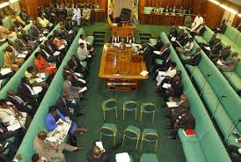
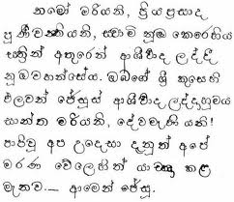
The need for formative research
Texting:
Parliamentarians
Banking
TB

Slide 41
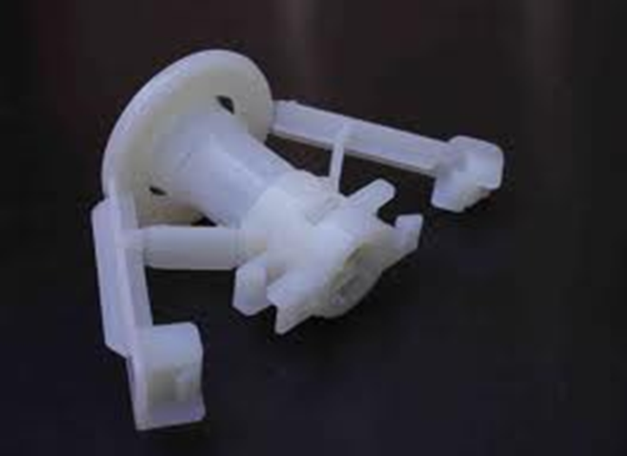
Large number of ‘good ideas’ few people want
Free male circumcision: 25% if free down to just 10% with partial subsidy
Pre-school in Mexico, fewer than 10% of parents who registered actually took part
Free bank accounts: only 20% started banking and 1/3 didn’t even take the ‘free money’
Insurance schemes typically less than 10% take up
Philippines just 7 out of 1,000
Pakistan also <1%

Slide 42
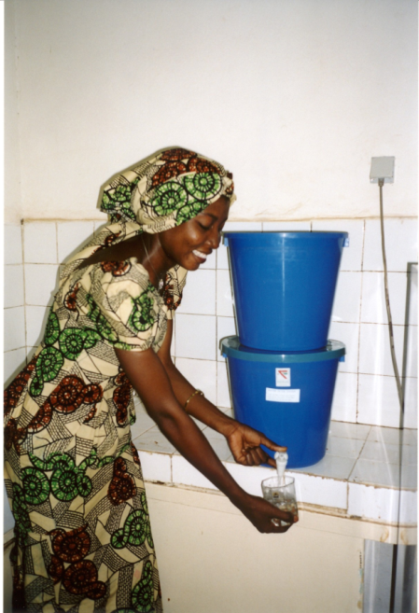
And participation declines over time
½ households stopped using improved cookstoves by 8 month follow up survey
Water treatment: fewer than 1/3 households using filters in Cambodia and pasteurising in Kenya after 3-4 years.. And only 5% disinfecting in Guatemala after just one year

Slide 43
Think about it a bit
Ghana cookstoves

Slide 44
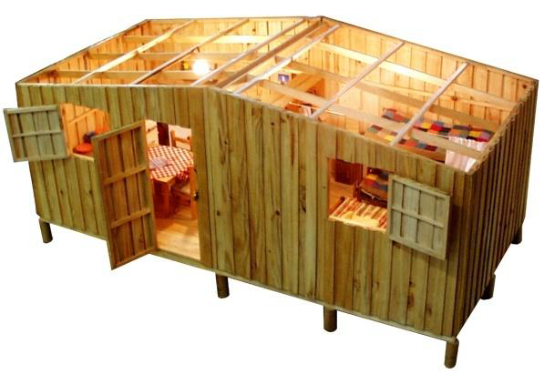
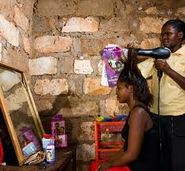
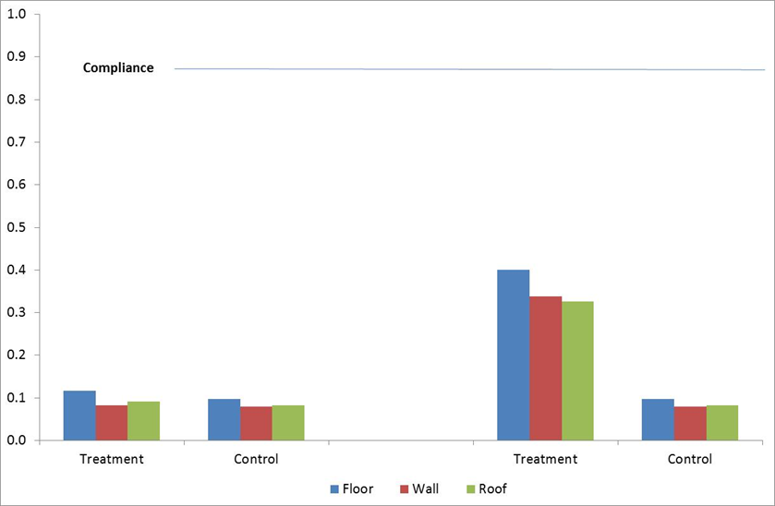
Don’t let me be misunderstood
The cult of significance

Slide 45
A typical theory of change
Inputs
Outputs
Outcomes
Processes

Slide 46
What it really looks like
Inputs
Outputs
Outcomes
Processes
Processes
Outputs

Slide 47
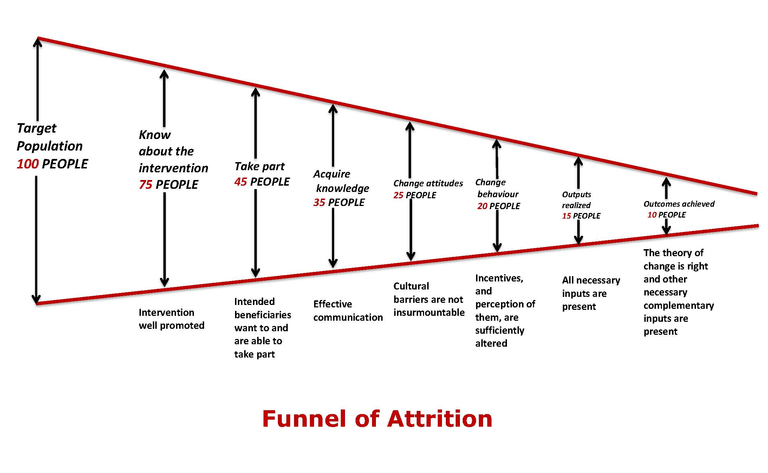
The funnel of attrition
Only these people may experience improved outcomes

Slide 48
An example from social funds

Slide 49
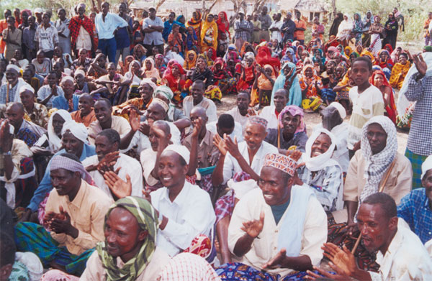
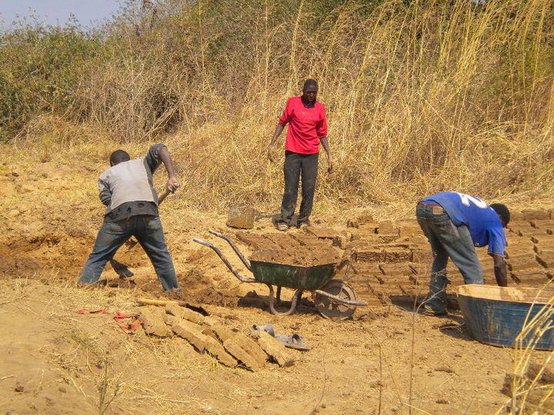
I have to go now. I have a community in my office

Slide 50
The funnel operates within steps in the causal chain
Show up
Attend
Stay awake
Pay attention
Understand
Agree
Absorb
Retain
Act

Slide 51
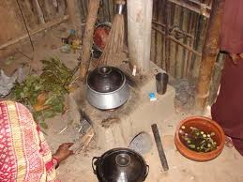
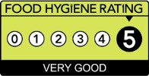
Examples of weak links
Improving hygiene in catering facilities in UK
Ghana cookstoves

Slide 52
Group exercise
It is 2025. Your project has failed to have an impact. What are possible reasons?
Use the funnel of attrition if you think it helps.
Refine your evaluation questions

Slide 53
Mid-level theory: an approach to generalizability and transferability with reference to hand washing and policy uptake of research findings
Howard White
CEDIL and Campbell Collaboration

Slide 54
What is it and why use it?
Mid-level (or mid range) theory: A theory of change between general theory and project-level theory
Tests causal mechanisms rather than specific interventions: so build evidence for mechanism
Helps assess transferability of findings

Slide 55
Generalizability and transferability
 | Definition | Examples
Generalizable | A finding which applies universally Prob(Y|X)=Prob(Y|Z) Ɐ X & Z Y is outcome; X and Z are states of the world (context) Very rare | Benefits of infant stimulation (and so benefit Parent Training IF they adopt behaviour)
 |  | Supervision of food supplementation to avoid leakage and substitution
Transferable | A finding which can be transferred from one setting to another as key contextual factors are similar Non-transferable: Prob(Y|X)≠Prob(Y|Z) Very common? | Not transferable: Nurse Family Partnership because of different context
 |  | Transferable: Conditional cash transfers for poor households

Slide 56
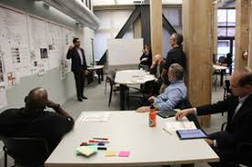
What I will talk about
Examples of mid-level theory
Focus on behaviour change
ALL development interventions have a behaviour change component
But here talk about hand washing and policy uptake of research findings

Slide 57
Three examples of mid-level theory
General theory | Mid level theory | Project-level theory
Supply & demand How the price mechanism clears the market for goods and services | Price subsides Price subsidies increase use of the subsidized agricultural inputs | Fertilizer subsidies to increase use of fertilizer in low productivity settings
Structuration theory How social systems are reproduced through an interaction between structures and agents | Role conflict Employment versus parenting: when incompatible demands are placed on people, complying with all of them will be difficult | Flexible working time to allow working parents to fulfill child care responsibilities
Transtheoretical model of behaviour change The six stage process individuals pass through for successful behaviour change | Providing information Providing information on benefits or harms of health behaviours will support behaviour change | Public information campaigns to promote handwashing with soap

Slide 58
Example: fill in for your intervention
General theory | Mid level theory | Project-level theory
Supply & demand How the price mechanism clears the market for goods and services | Price subsides Price subsidies increase use of the subsidized agricultural inputs | Fertilizer subsidies to increase use of fertilizer in low productivity settings

Slide 59
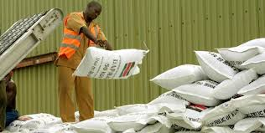
Price elasticities: cost is not always the binding constraint
Free male circumcision: 25% if free down to just 10% with partial subsidy. So price makes a difference, but even if free most uncircumcised men don’t change behaviour
Subsidized pensions limited impact on pension enrolment. But opt out rather than opt in has huge impact
Fertilizer subsidy may not increase uptake if inadequate knowledge, lack market for produce or lack complementary inputs

Slide 60
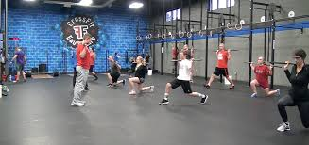
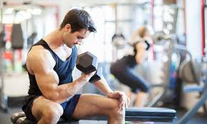
A story from Quora
I was obese, under conditioned and drinking quite a bit
My Dad was becoming less mobile from years of being overweight. He would no longer visit my kids because he was unable to climb stairs. This was a big wake up call for me. It took me 6-8 months contemplating how to start…
I looked at what my husband was doing and checked out some gyms nearby…
I joined a ‘Stay Mobile’ fitness class 3 days a week
I made a commitment to go to crossfit 4 days a week for the first 30-60 days with no excuses
I look forward to going to work out. I miss being at the gym on rest days… I know I in a fitness programme for life

Slide 61
This story illustrates the transtheoretical model of behaviour change: six stages of behaviour change
Stage | Definition
Pre-contemplation | Not seriously thinking changing behaviour
Contemplation | Seriously thinking about changing behaviour in the next 6 months + but not within the next 30 days + no attempt in the past year
Preparation | Seriously thinking about changing behaviour in the next 30 days
Action | First 6 months of change
Maintenance | Change beyond 6 months
Termination | Complete absence of temptation for previous behaviour

Slide 62
A story from Quora
Pre-contemplation
I was obese, under conditioned and drinking quite a bit
My Dad was becoming less mobile from years of being overweight. He would no longer visit my kids because he was unable to climb stairs. This was a big wake up call for me. It took me 6-8 months contemplating how to start…
Contemplation
Preparation
I looked at what my husband was doing and checked out some gyms nearby…
I joined a ‘Stay Mobile’ fitness class 3 days a week
Action
I made a commitment to go to crossfit 4 days a week for the first 30-60 days with no excuses
Maintenance
I look forward to going to work out. I miss being at the gym on rest days… I know I in a fitness programme for life
Termination

Slide 63
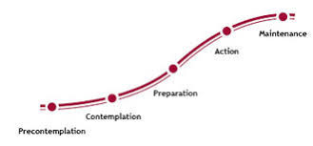
Transtheoretic model provides a good framework for mid-level theory approach to behaviour change
A key insight is that the different stages of the process require different interventions

Slide 64
Pre-contemplation
Mid-level theory: Exposure to information on benefits of handwashing with soap (harms from not doing so) will lead people to consider changing behaviour (transition from pre-contemplation to contemplation)

Slide 65
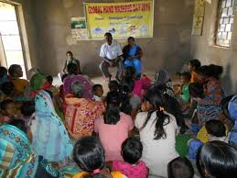
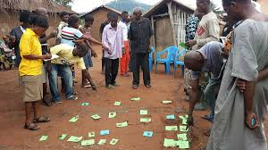
Pre-contemplation
Mid-level theory: Community engagement in identifying sanitation-related problems and solutions can change social norms regarding handwashing and open defecation

Slide 66
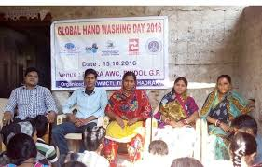
Pre-contemplation
Indicators
Interventions
Public information (posters, media)
Community meetings (awareness raising)
Community influencers (community and religious leaders, TV stars)
Entertainment based (street theatre, soap operas, movies)
School-based
Social norms
Attitudes & beliefs

Slide 67
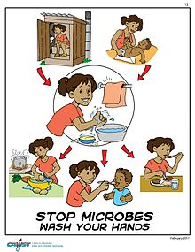
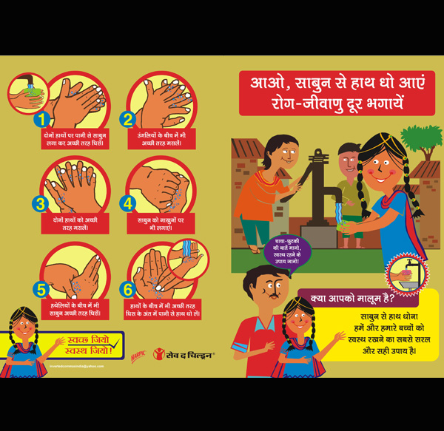
Contemplation and planning
Mid-level theory: Providing information on when and how to carry out handwashing with soap will improve knowledge of correct practice (using soap, frequency and duration)

Slide 68
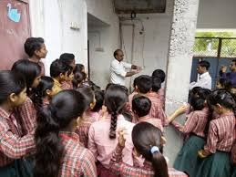
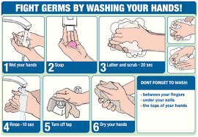
Contemplation and preparation
Indicators
Interventions
Public information (posters, media)
Community meetings with demonstrations
Entertainment based (street theatre, soap operas)
School-based demonstrations
Social norms
Attitudes & beliefs
Knowledge

Slide 69
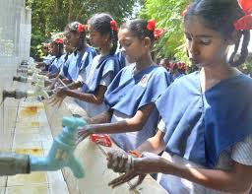
Action
Mid-level theory: Financial and non-financial incentives will support adoption of proper handwashing practice

Slide 70
Action
Indicators
Interventions
Handwashing facility available
Soap present and used in household
Proper practice
Financial incentives:
Soap subsidy
Vouchers
Non-financial incentives:
Giving soap (school or household)
Handwashing facilities
Awards to community-leaders
Community peer pressure

Slide 71
Maintenance
Mid-level theory: Following correct handwashing practice for sufficient duration will turn the practice into a habit (sustained proper practice)

Slide 72
Action
Indicator
Interventions
Sustained proper practice
Handwashing facilities
Supply chain (possible subsidy)

Slide 73
What about the evidence?

Slide 74
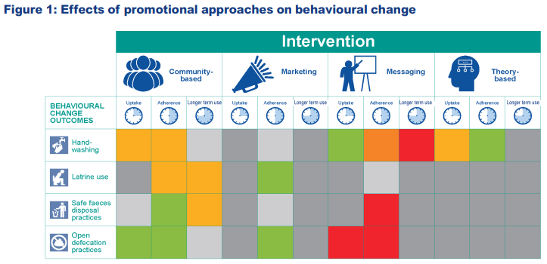
Results as expected: Community-based approaches no evidence maintenance of effect Marketing evidence is adherence Messaging main impact on uptake

Slide 75
AND…
Multi-component programmes more effective:
Community-based approaches work better if add incentives
Combining media campaign with community involvement had impact on knowledge and behaviour, whereas campaign alone did not
One way messaging generally not effective, but may be so with community engagement

Slide 76
Lessons
Mid-range theory identifies range of interventions which may be appropriate to operate a mechanism
Different interventions needed to operate different mechanisms (at different stages of causal chain)
So multi-component programmes more effective (or coordinate between agencies)
Primary studies, and especially systematic reviews, can test both interventions and mechanisms

Slide 77
Application to policy uptake of evidence
Stage | Theory | Interventions
Pre-contemplation | Exposure to cases of successful use of evidence will increase willingness to consider evidence-based policy | Develop cases of cost savings and welfare impact when evidence has been used Awareness raising workshops (how evidence is being used elsewhere, local examples where there is relevant evidence) Media stories on use of evidence national and globally
Contemplation | Learning different sources and uses of evidence will encourage action and thinking about own possible uses | Use of evidence workshops Evidence needs assessment

Slide 78
Stage | Theory | Interventions
Preparation and action | Policy makers benefit from guidance to navigate the evidence | Activities to identify relevant stakeholders to be engaged, and policy issues to be addressed Direction interaction to interpret available evidence Prepare evidence summaries / briefs
Action | As policy makers become more experienced they can seek out and use evidence themselves (using available research and evidence resources) | Guide users to evidence resources Generate nationally-specific evidence resources
Maintenance |  | Use of evidence assessments and awards for use of evidence Develop national evidence architecture Build evidence courses into civil service training

Slide 79
In summary
Thank you
Visit www.campbellcollaboration.org

